Slide 1

PROCESS MINING VIRTUAL INTERSHIP
by
G.LIKHITHA
204G1A3245
Department of Computer Science and Engineering (Data Science)
Srinivasa Ramanujan Institute of Technology
(Affiliated to JNTUA & Approved by AICTE) (Accredited by NAAC with ‘A’ Grade & Accredited by NBA (EEE, ECE & CSE)
Rotarypuram Village, B K Samudram Mandal, Ananthapuramu – 515701.
2023 - 2024

Slide 2

Contents
Course Objective
Introduction
Technology
Applications
Modules
Real Time applications
Learning outcomes
GitHub Link
Queries

Slide 3
OBJECTIVE :
Process mining is a technique designed to discover, monitor and improve real processes (i.e., not assumed processes) by extracting readily available knowledge from the event logs of information systems. Process mining includes:
Automated process discovery (extracting process models from an event log).
Conformance checking (monitoring deviations by comparing model and log)
Social network/organizational mining
Automated construction of simulation models
Model extension
Model repair
Case prediction
History-based recommendations

Slide 4
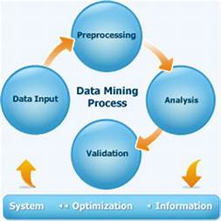
INTRODUCTION :
mining applies data science to discover, validate and improve workflows. By combining data mining and process analytics, organizations can mine log data from their information systems to understand the performance of their processes, revealing bottlenecks and other areas of improvement.
Process mining leverages a data-driven approach to process optimization, allowing managers to remain objective in their decision-making around resource allocation for existing process.

Slide 5
TECHNOLOGY :
Data Cleaning :
Teams need to first clean all process data so it aligns with the industry standard. Dirty or incomplete data leads to poor insights and system failures that cost time and money. Engineers will remove all unclean data from the organization's acquired data
Data Integration :
When data miners combine different data sets and sources to perform analysis, they refer to it as data integration. This is one of the top mining techniques to streamlines the entire extract, transform, and load process.
Data Reduction for Data Quality :
This standard process extracts relevant information for data analysis and pattern evaluation. Engineers take a small size of the data and still maintain its integrity during data reduction. Teams may use neural networks or other forms of machine learning during this mining process.

Slide 6
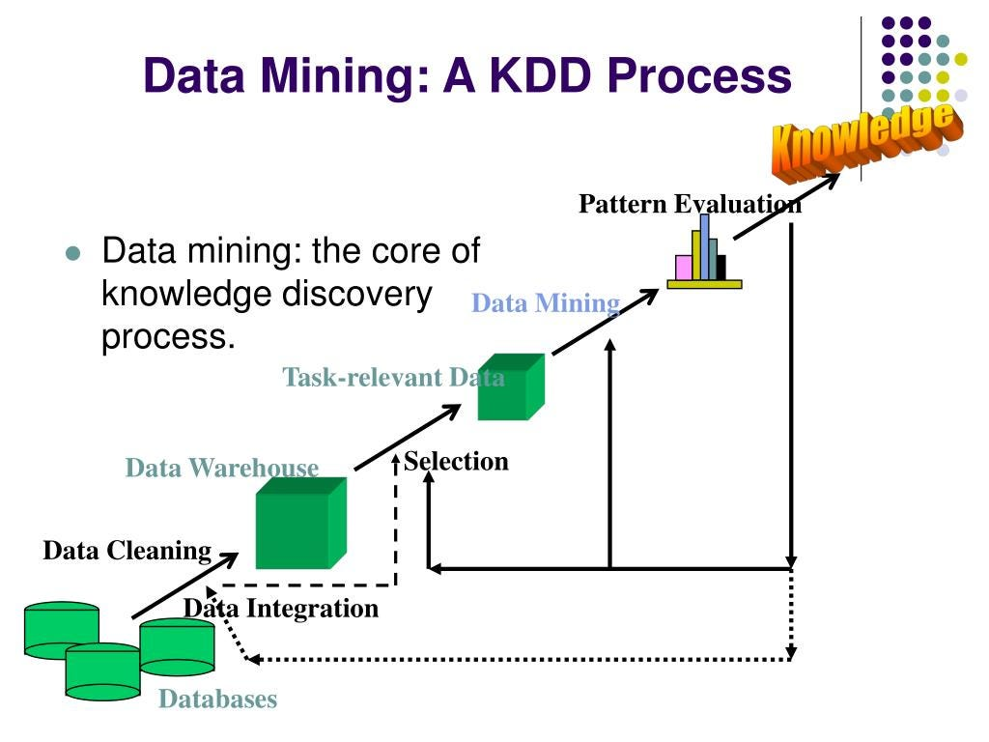
.

Slide 7
Data Transformation : In this process, engineers transform data into an acceptable form to align with mining goals. They consolidate the preparation data to optimize data mining processes and make it easier to discern patterns in the final data set. Data Mining : Organizations use data mining applications to extract useful trends and optimize knowledge discovery to generate business intelligence. This is only possible if a company takes full advantage of big data and collects the correct type of information Pattern Evaluation : This is the stage where engineers stop working behind the scenes and bring insights into the real world. Specialists will pinpoint any useful patterns that can generate business knowledge. Representing Knowledge in Data Mining : Finally, data analysts use a combination of data visualization, reports, and other mining tools to share the information with others. Before the data mining process even started, business leaders communicated data understanding goals and objectives so engineers knew what to look for Now, analysts can share their findings with these leaders in the form of reports.

Slide 8
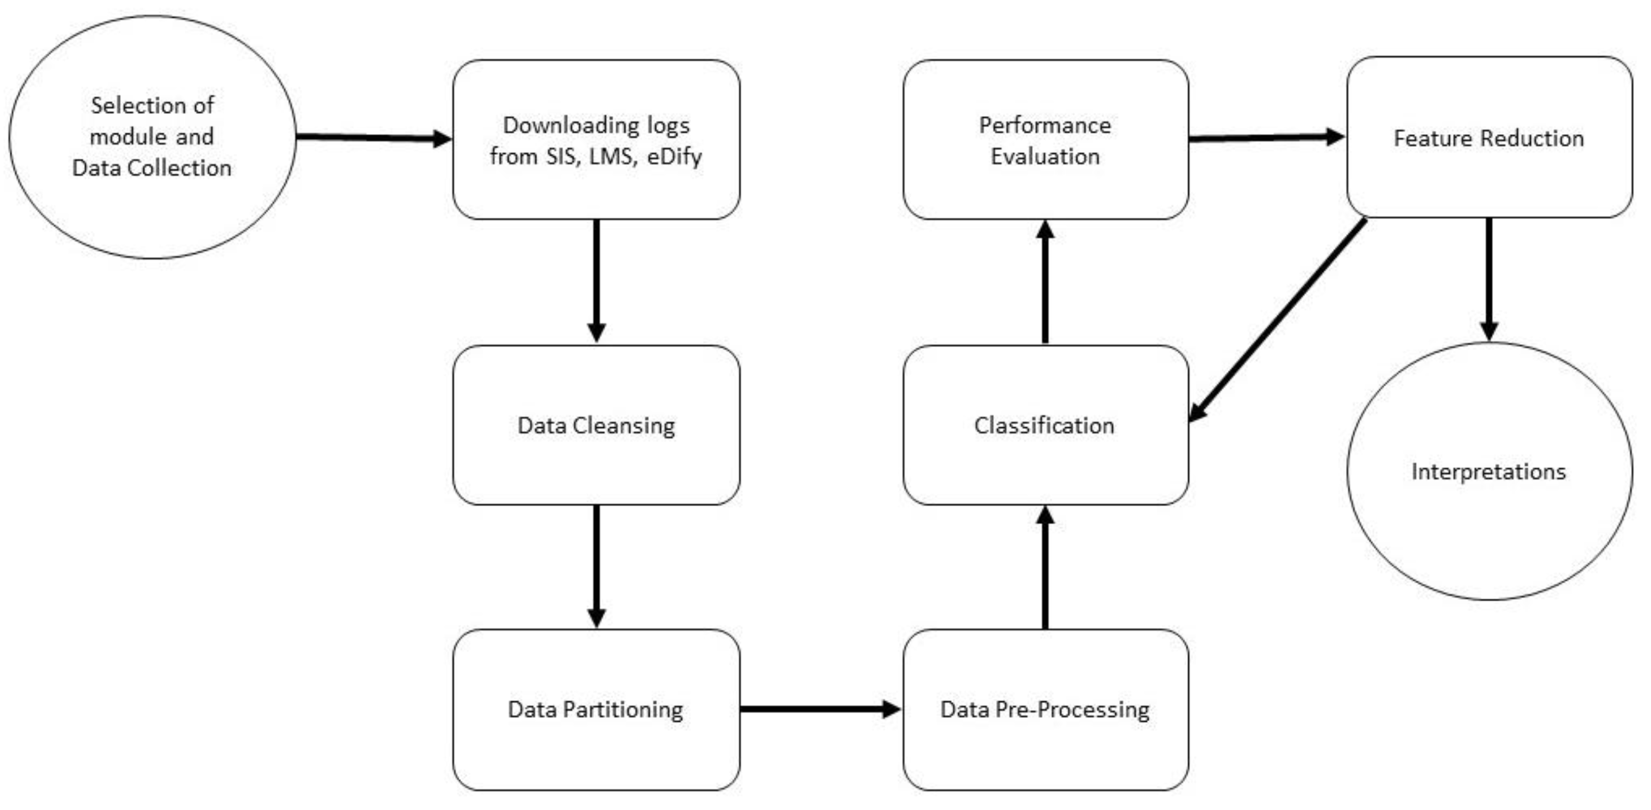
MODULE :

Slide 9
REAL TIME APPLICATION :
Marketing
Intrusion detection
Lie detection
Corporate surveillance
Bioinformatics
E-commerce
Retair
Service provides

Slide 10
Learning outcomes:
This Internships allow us to gain experience prior to searching for full-time employment.
Put our theoritical knowledge of process mining into practice.
To examine the types of the data to be mined and present a general classification of tasks and primitives to integrate a data mining system.
To helps to work with the data and process it to apply on real world applications to make application feasible and to improve the soft skills of learners.

Slide 11
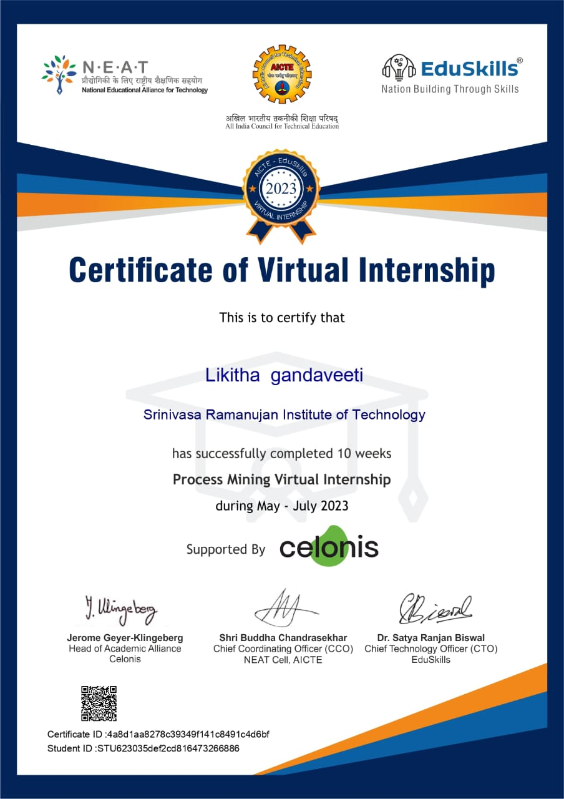
Certification :

Slide 12
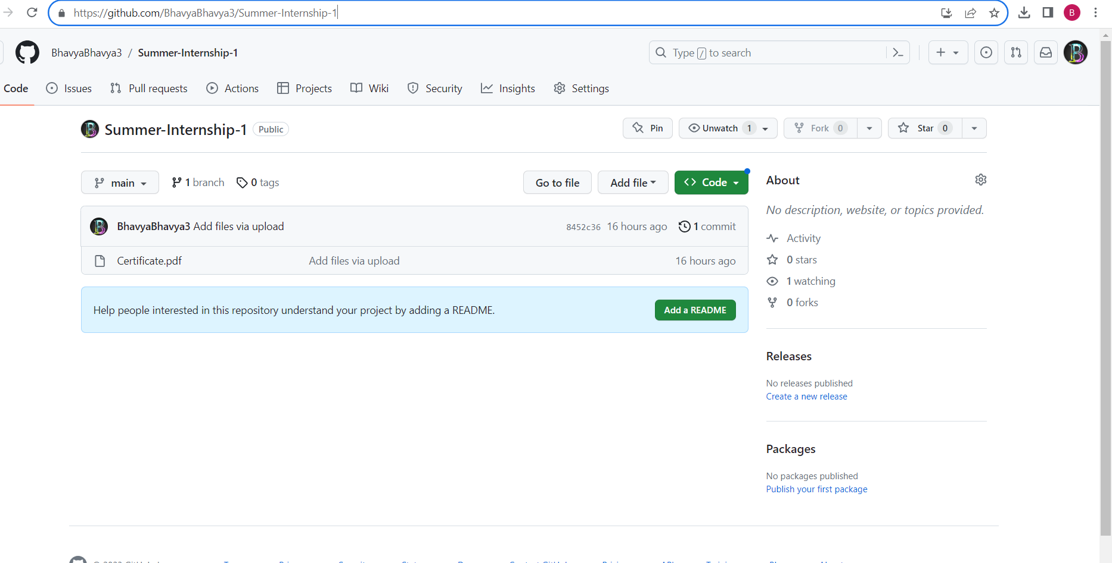
GIT HUB DASHBOARD :
Link : https://github.com/G . LIKHITHA/Summer-Internship-1

Slide 13
CONCLUSION :
Process mining is a powerful tool that can help organizations to identify , optimize processes, reduce costs and increase efficiency. It requires careful implementation to overcome challenges and realize its potential..
By this I learnt about the event log and also how to increase the service cost, how to process the data.
Learnt about PQL queries.

Slide 14
REFERENCES :
https://core.ac.uk/download/pdf/143395465.pdf
https://www.indeed.com/career-advice/career-development/process-mining

Slide 15
THANK YOU

